Slide 1

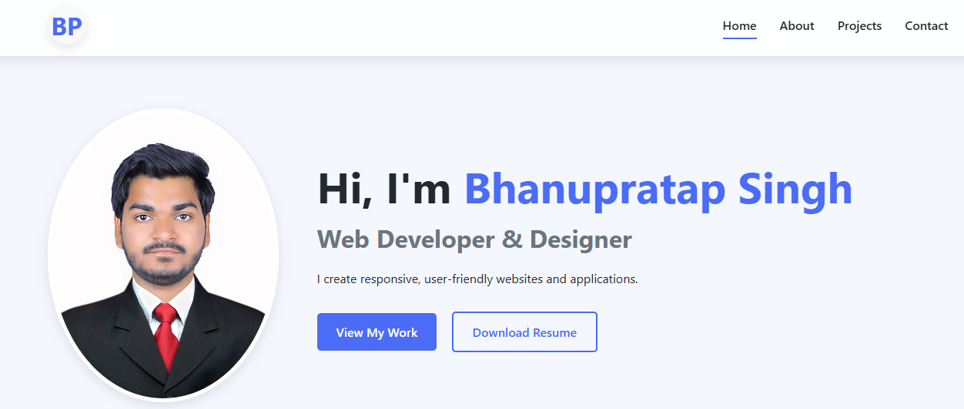
Personal Portfolio Website
This report details the journey of creating a personal portfolio website
using HTML, CSS, and JavaScript. The primary goal was to develop an online
platform that effectively showcases skills, projects, and contact information
in a professional and engaging manner. The development process, features,
challenges, and key learnings are outlined, providing a comprehensive
overview of the project from inception to completion. The portfolio serves
as a dynamic online resume, designed to evolve with ongoing professional
growth.

Slide 2
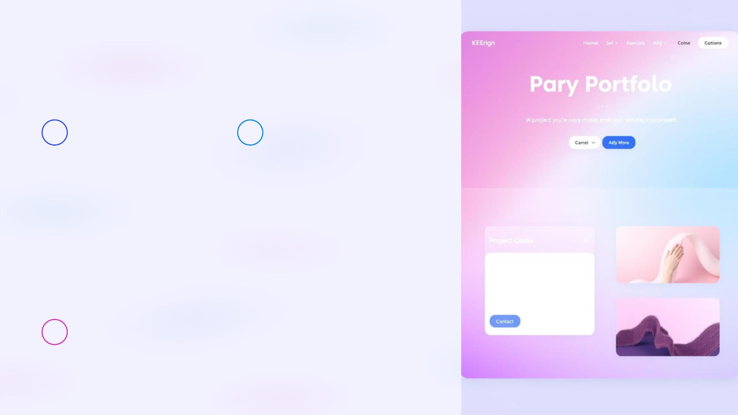
Key Features Implemented
Core Sections
Interactive Elements
Implemented essential
sections including a
Home/Hero area, About Me,
Projects, Resume, and
Contact Form. Each section
is designed for clear
communication and easy
navigation.
Enhancements with a
responsive navigation bar,
smooth scrolling, and
optional dark/light mode
toggle improve user
engagement.
Fully Responsive
Built to function on all devices from desktop to mobile.

Slide 3

Technologies Employed
HTML5
CSS3
JavaScript
HTML5 structured the page to organize
content.
CSS3 was used for styling and
animation.
JavaScript provides interactive
elements.
The project leverages core web technologies to create a robust and visually appealing portfolio. HTML5 provides the structure,
CSS3 handles the styling and animations, and JavaScript adds interactive elements. Flexbox and Grid were crucial for layout
organization, while Google Fonts and Font Awesome enhanced typography and provided icons, improving the overall design
aesthetic.

Slide 4
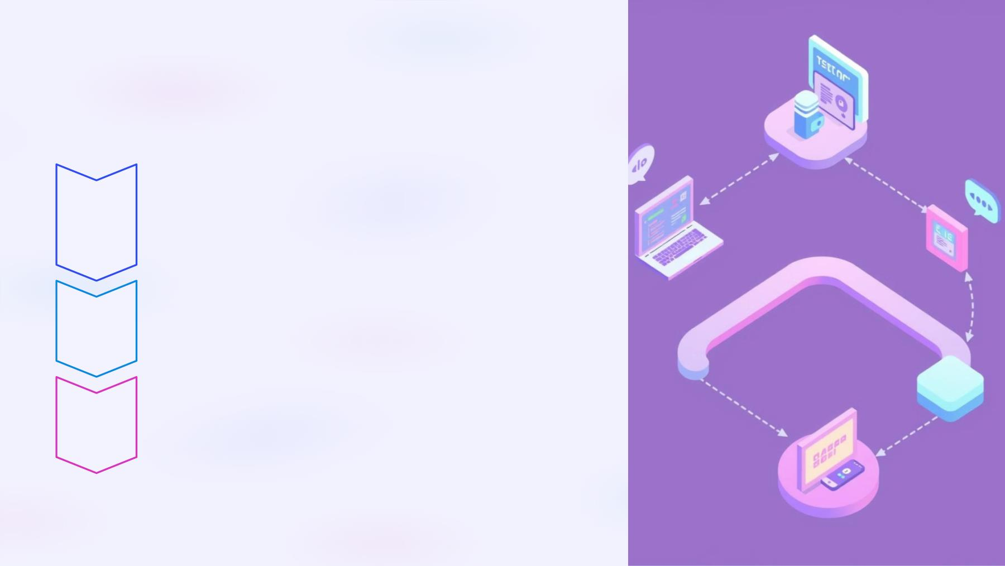
Development Process
HTML Structure
1
Utilized semantic HTML5 tags to improve accessibility and
SEO.
CSS Styling
2
3
Employed a mobile-first approach to ensure responsiveness.
Layouts
Flexbox and Grid provide modern layout techniques.

Slide 5
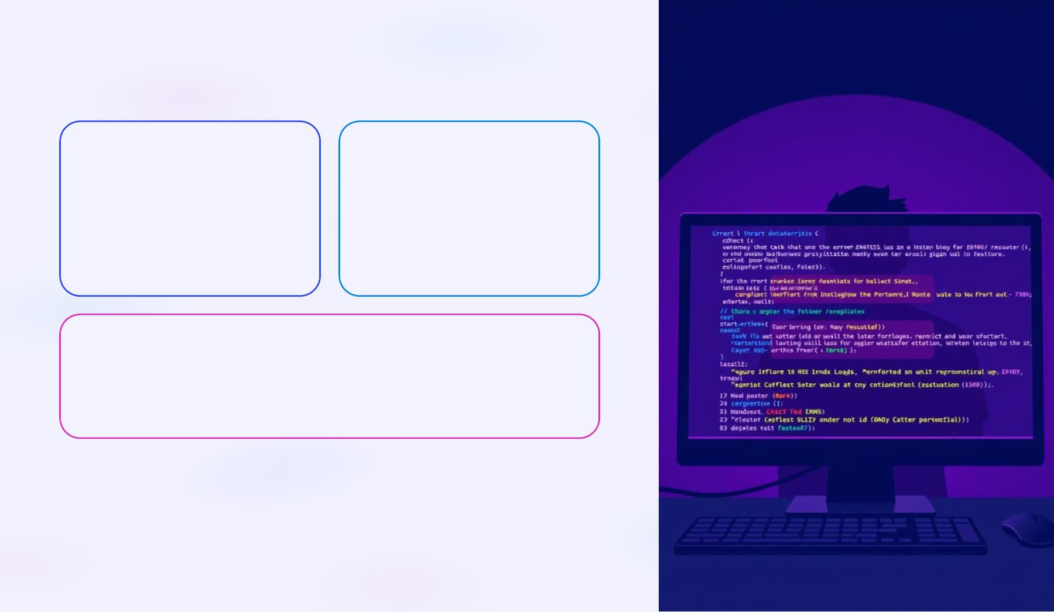
Challenges Encountered
Responsive Design
Cross-Browser
Compatibility
Adapting the layout across
various devices was a complex
task.
Ensuring consistent rendering
across different browsers
required fallbacks.
Form Handling
Implementing client-side validation without a backend presented
difficulties.
Several challenges were faced during development, including ensuring
responsive design, maintaining cross-browser compatibility, and
implementing form handling. These challenges required creative problem-
solving and a deep understanding of web development best practices.

Slide 6
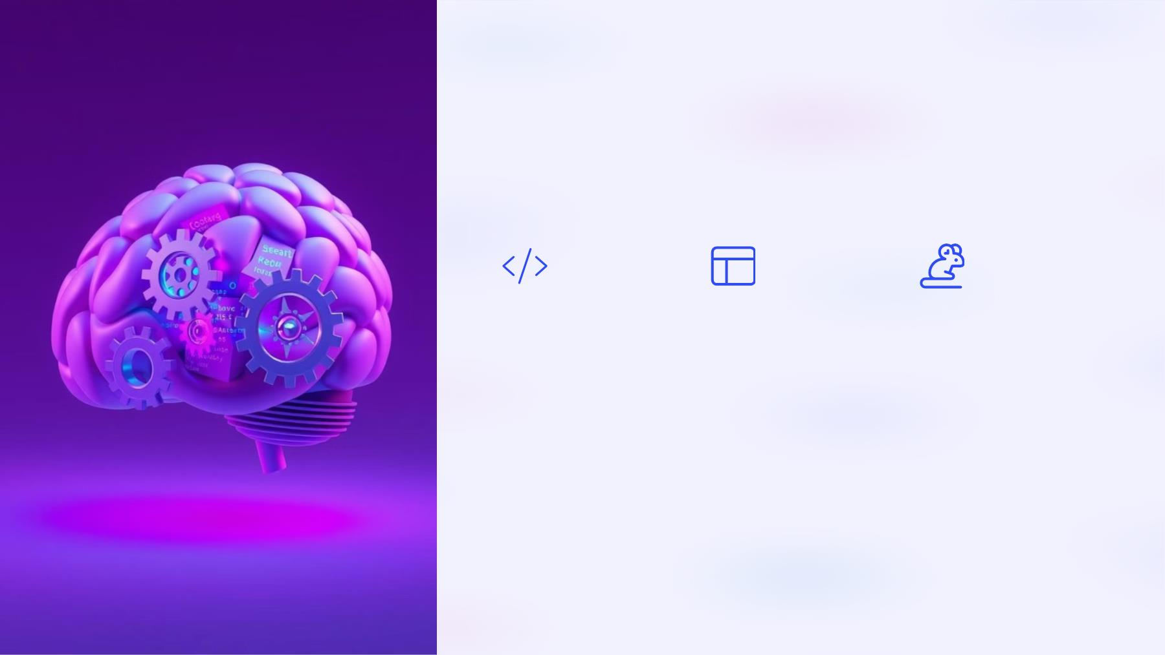
Key Learnings and Insights
Semantic HTML
CSS Grid/Flexbox JavaScript Events
Improved
Mastered modern
Enhanced skills in
DOM manipulation
and event handling.
understanding of
accessibility and SEO
through semantic
HTML.
layout techniques for
responsive designs.

Slide 7
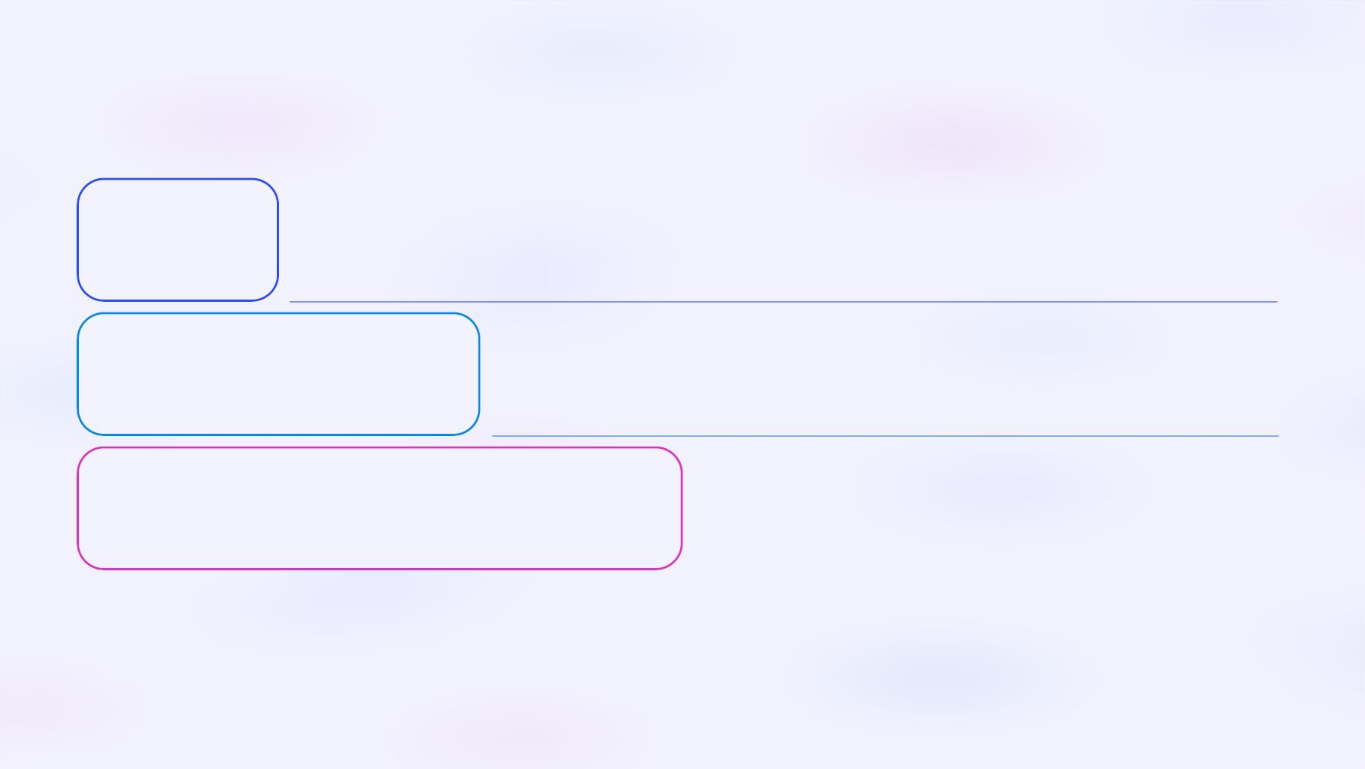
Future Enhancements
Backend Integration
1
Connect the contact form to a server.
Blog Section
2
Add a dynamic blog using a CMS like Sanity.io.
Advanced Animations
3
Incorporate GSAP or ScrollReveal.js for animations.
Future enhancements include backend integration to handle form submissions, adding a dynamic blog section using a CMS for
content management, and incorporating advanced animations using GSAP or ScrollReveal.js to enhance the user experience. These
updates will further improve the functionality and design of the portfolio.

Slide 8
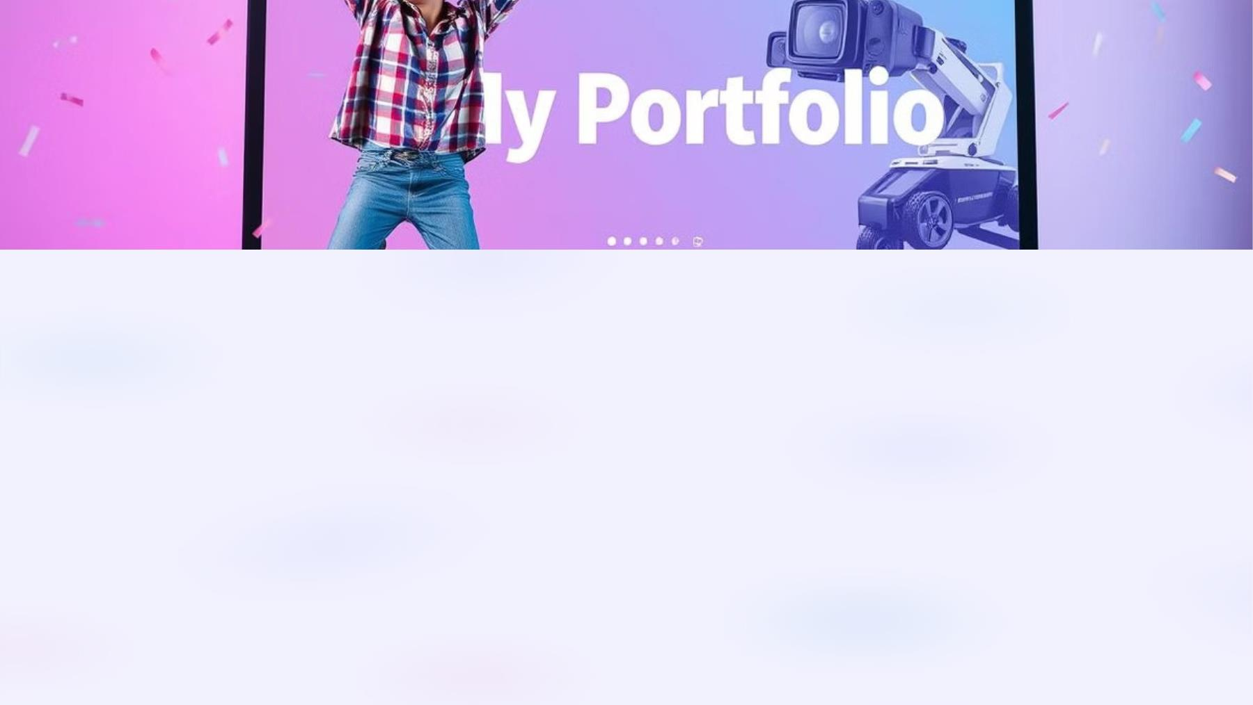
Conclusion
This project successfully delivered a fully responsive personal portfolio, demonstrating proficiency in front-end development and
providing a professional online presence. The portfolio effectively showcases skills and projects, offering a platform for career
advancement. With future updates, the functionality and design can be further enhanced. The project serves as a valuable learning
experience and a solid foundation for future web development endeavors.

